Slide 1
caArray User Community Meeting
1.5 Release Update and the path forward
Call in: 877-416-5524
Participant Passcode: 2627056
Centra: http://ncicb.centra.com
Meeting ID: array_june20
June 20, 2007

Slide 2
Agenda
Introduction
1.5 Release (available June 21)
  What’s in it
Upcoming Releases
2.0 Update
  Where we are
  What are the expected results
  What we need from the user community

Slide 3
caArray 1.5 – Key Features
Supported array data formats will be imported through caAMEL or the portal
Data available as BioDataCubes via the MAGE-OM API
Enhanced MAGE-OM API Search Capability
  Facilitates searches for Experiments, MeasuredBioAssays, DerivedBioAssays, as well as ArrayDesign and Reporter data
User interface for Administrator functions
Updated terminology in the user interface (ex: “BioSource” is now “Source”)
Supported expression formats:
  Affymetrix, GenePix, Agilent, Illumina, ImaGene, MAGE-ML, UCSF Spot
Removal of bad .jar file from production installation
  Addresses a significant number of issues that relate to the inaccessibility of data due to faulty permission errors or the corrupting of cached data

Slide 4
caArray 1.5.0.1
We are currently planning for a patch release that will come out soon after 1.5 to address a poor performing Array search
  Search in which no filters are applied does not return
  The production site will not be affected but we will announce its availability

Slide 5
caArray 1.6
We are currently scoping 1.6 which we anticipate being available in mid-August
  Main purpose is to run the Array bulk loader to parse files that were submitted to caArray while parsing has been unavailable
  Additional items are currently tagged in GForge and will be confirmed shortly

Slide 6
caArray 2.0
The 2.0 Schedule has been pushed 5 weeks to address critical 1.x issues
Inception was completed but Elaboration postponed. The major accomplishments of Inception were:
  Establish the Vision and document the features for caArray going forward
  Hold Stakeholder Interviews and receive priority based feedback
  Propose the architectural path forward
  Implement 1 path to test the proposed architecture (Manage Protocols)

Slide 7

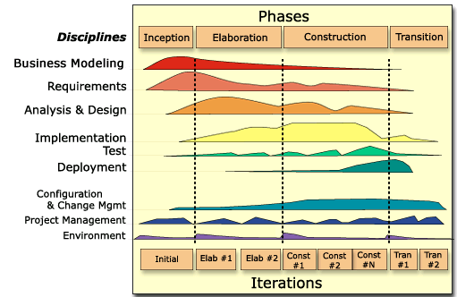
Where We Are
2.0 Elaboration Iteration 1
  begun
E1 Scheduled for completion:
  August 1, 2007

Slide 8
What are the expected results of E1
Project Management:
  Refine 2.0 Schedule, Detail E2 Schedule
Requirements:
  Update Vision and Supplemental Specification
  Write All Elaboration Use Cases (E1+E2)
  Establish Community Reviewers of major functional areas
Analysis and Design
  Targeted UC A&D
  Strategy for Grid, Parsing, Storage, Security and 1.6 Data Migration
  Representation of SNP Data
Implementation
  Begin architectural proof of Upload, Extraction, Workflow, Security

Slide 9
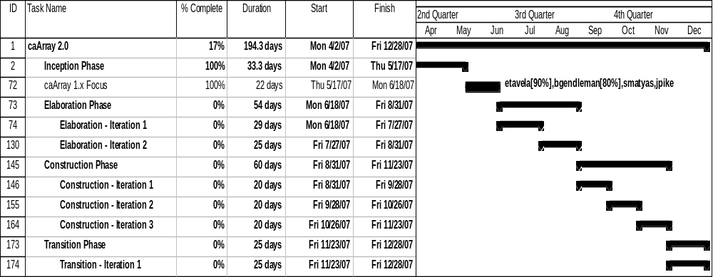
Current 2.0 Schedule

Slide 10
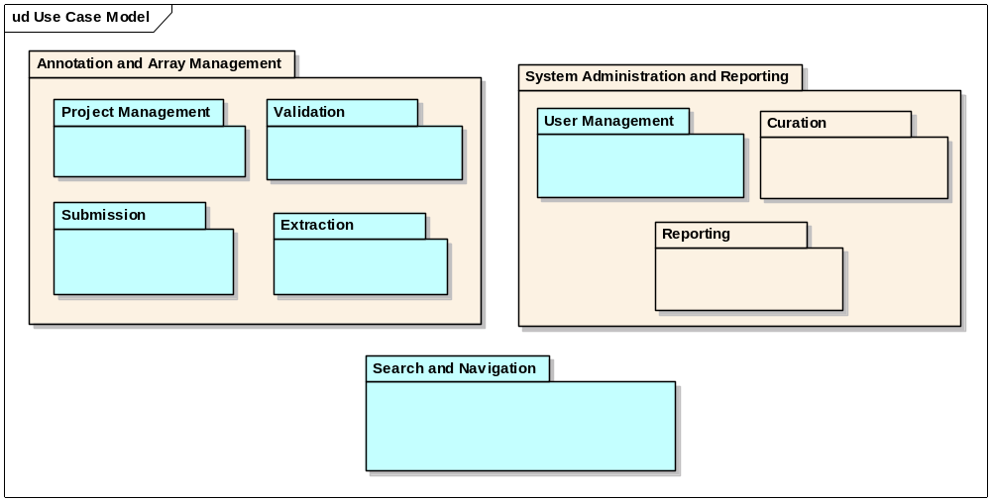
2.0 Use Case Model

Slide 11
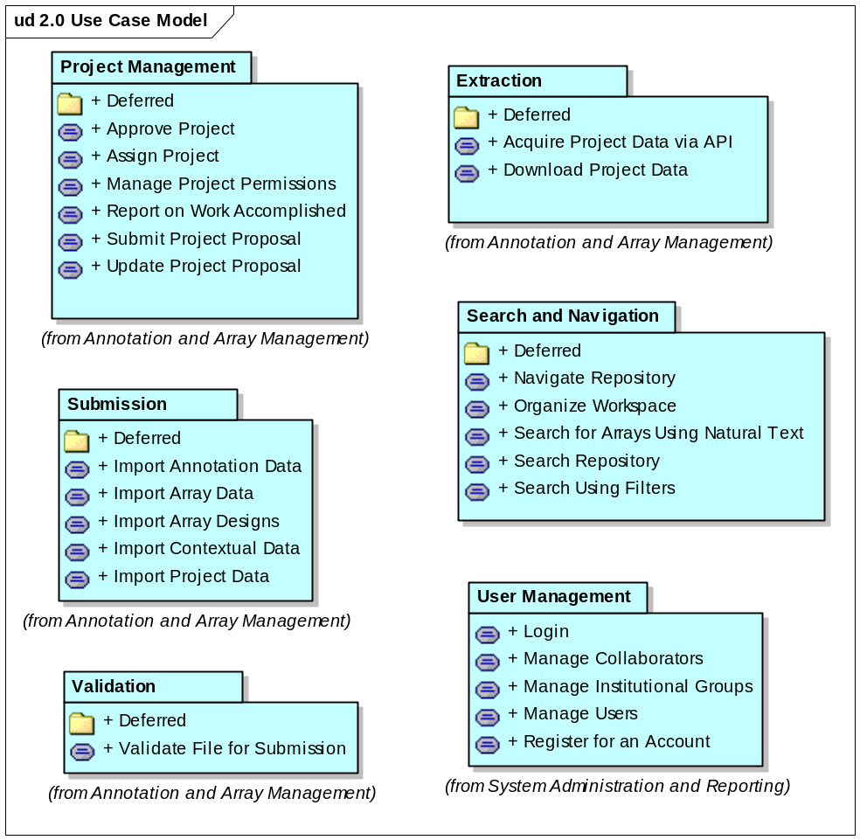
Initial Prioritization for 2.0 Use Cases

Slide 12
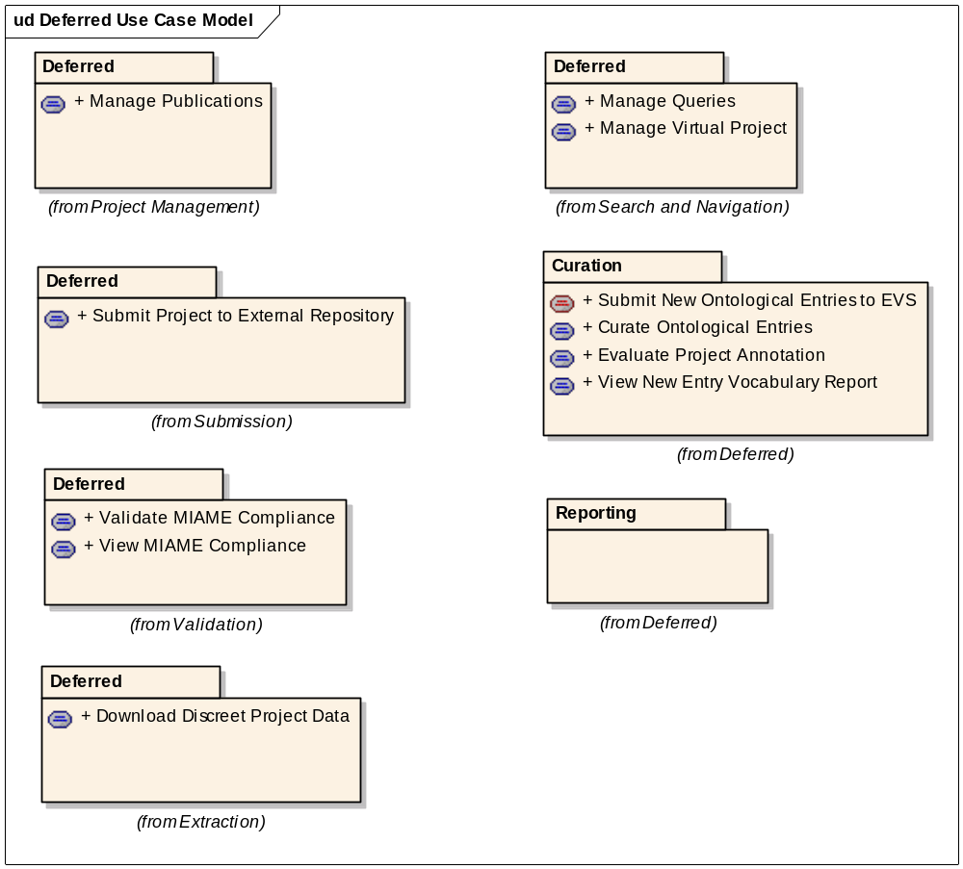
Deferred Use Cases

Slide 13
What we need from you and when
Initial Priority Acquired – Thank You!
Now we need your input into refining the requirements
  We need volunteers to review use cases and/or the supplemental specifications for these functional areas
    Project Management (e.g., Workflow)
    Submission
    Extraction
    Validation
    Search and Navigation
    User Management and Collaboration
    SNP Data Representation
    Local Installer IT Issues – e.g. HTTPS, Port Exposure, etc.)

Slide 14
Process for Refining Requirements
Volunteer for a functional area right now or send Juli Klemm an email indicating your willingness to do so and for which area
As we gain volunteers, we’ll inform the list serve until we have all areas covered
We will ensure you get access to the appropriate documentation and establish a timeline for it’s review
We will set up a conference call to discuss your review and incorporate feedback going forward
We will also set up forums on each functional area to encourage others to contribute ideas and critique

Slide 15
Continuing Engagement Model
Continue Monthly Meetings
G-Forge site for 2.0 is available that indicates needs, features, use cases and test cases
  We will continue to publish regularly and investigate forums and surveys for targeted feedback
G-forge site: https://gforge.nci.nih.gov/projects/caarray2/

Slide 16
Next Steps
Please visit G-Forge: https://gforge.nci.nih.gov/projects/caarray2/ to view the prioritization of features and use cases (Tracker items)
Look for the published results of Elaboration Iteration 1 July 27th, 2007
Next meeting date: TBA but anticipated July 18, 2007

